Slide 1

Cyber Security
Re-Introduction,Future Plans, And Resources
Cybersecurity E-JUST club Instructor - Zaina Wael

Slide 2
CONTENTS
What is cybersecurity? | A small re-introduction into the digital world and it’s security systems
Job market | A look into how the job market looks like? Roles, Saturation, Salaries, And more
Tracks | A general but not comperhensive guide into the different tracks of cyber security
Resources | A list of links for Certifications, Internships,Newsletters, And Self learning
References | Links to read more into our resources for this specific presentation in case of wanting to read some more
What’s next? | A sneak peak into our club’s plan :D

Slide 3
Breaking news!
AI-related illicit activity surged 1,500% in a single month!
3.3B compromised credentials are now fueling identity-based attacks!
Ransomware incidents increased 53% as groups pivot toward pure-play extortion.
-flashpoint annual threat intelligence report

Slide 4
01
What is cyber security?

Slide 5
Cybersecurity is the practice of protecting systems, networks, and programs from digital attacks. These cyberattacks are usually aimed at accessing, changing, or destroying sensitive information; extorting money from users through ransomware; or interrupting normal business processes.
-cisco

Slide 6
02
Job market

Slide 7
Roles
Cyber security engineer
Cyber security analyst
Network security engineer
Security application developer
White hat
Penetration testing
Forensics investigator
SOC engineer
CISSP, Cisco (CCNP), CompTIA (CASP+), CompTIA (CySA+)
CompTIA Network+, CompTIA Security+, CompTIA PenTest+, CySA+, CISSP
CompTIA Network+, ISC2, GIAC, (NSE) 7
Microsoft Azure
PEN-200, GIAC,

Slide 8
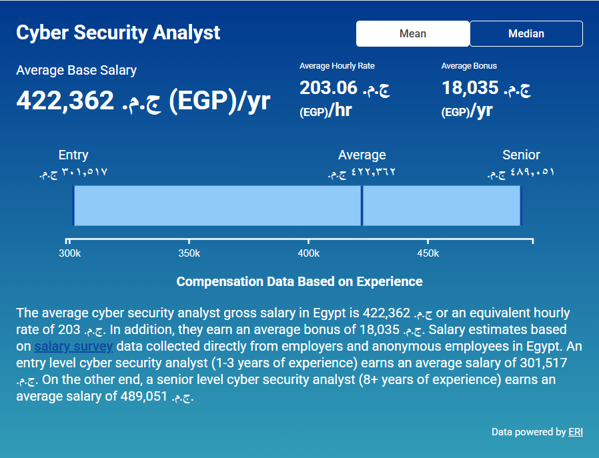
Salaries

Slide 9
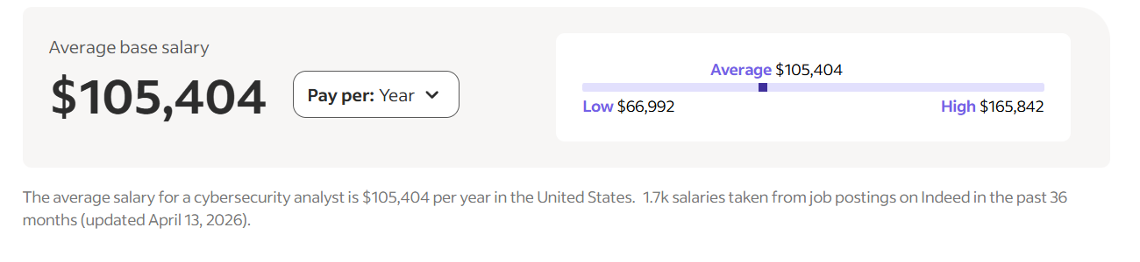
Salaries

Slide 10
03
Tracks

Slide 11
Teams
Red Team: The Attackers
Identifying and Mitigating Vulnerabilities: By uncovering weaknesses, Red Teams help organizations address security gaps before real attackers can exploit them.
Enhancing Incident Response: They provide critical insights into how an organization might be attacked, improving the effectiveness of incident response strategies.
Comprehensive Reports: Red Teams deliver detailed reports that include findings, impact assessments, and actionable recommendations for strengthening security measures.
Blue Team: The Defenders
Monitoring and Detection: Blue Teams use
advanced tools such as Security Information
and Event Management (SIEM) systems to
continuously monitor network traffic and
system activity for anomalies and potential
threats.
Incident Response: They are on the frontline of
defense, responding to real-time security
incidents. This involves identifying the scope
of an attack, containing the threat, eradicating
malicious activity, and recovering affected
systems.

Slide 12
Teams
Purple Team: The Collaborators
Knowledge Sharing: Purple Teams facilitate the exchange of information between Red and Blue Teams, ensuring that both sides understand each other’s methodologies and findings.
Joint Exercises: They conduct collaborative security drills and exercises, where Red and Blue Teams work together to test and improve security measures.
Continuous Improvement: Purple Teams are focused on implementing strategies that continuously enhance the organization’s defenses, using feedback from both offensive and defensive operations.
Yellow Team: The Builders
Software Development: Yellow Teams create
secure applications by following best practices
in secure coding and software development.
Collaboration with Red and Blue Teams: They
use insights from Red Team assessments and
Blue Team defenses to improve the security
features of software and applications.
Security Feature Enhancement: Yellow Teams
continuously work on integrating advanced
security measures into software products to
prevent vulnerabilities.

Slide 13
Teams
Orange Team: Facilitating Interaction and Education
Educating Developers: Orange Teams share
knowledge and insights from attack simulations
to help developers understand potential
vulnerabilities.
Improving Security Practices: They guide
developers in adopting secure coding practices
and implementing robust security measures.
Ensuring Application Security: Orange Teams
assist in creating secure, bug-free software by
incorporating security considerations into the
development lifecycle.
Green Team: Enhancing Security Automation with Design and Code
Secure Software Development: Green Teams
implement secure coding practices to prevent
vulnerabilities during development.
DevSecOps Integration: They integrate security
into DevOps workflows, ensuring continuous
security assessment and automation.
Policy Development: Green Teams develop and
enforce security policies and procedures to
maintain a secure development environment.

Slide 14
04
Resources

Slide 15

Newsletters
Krebs on security (weekly)
SANS newsbites (bi-weekly)
Threats without borders (weekly)
TDLR infosec (daily)
Vulnerable U (weekly)
API security (bi-weekly)
Blockchain threat intellegince (weekly)

Slide 16
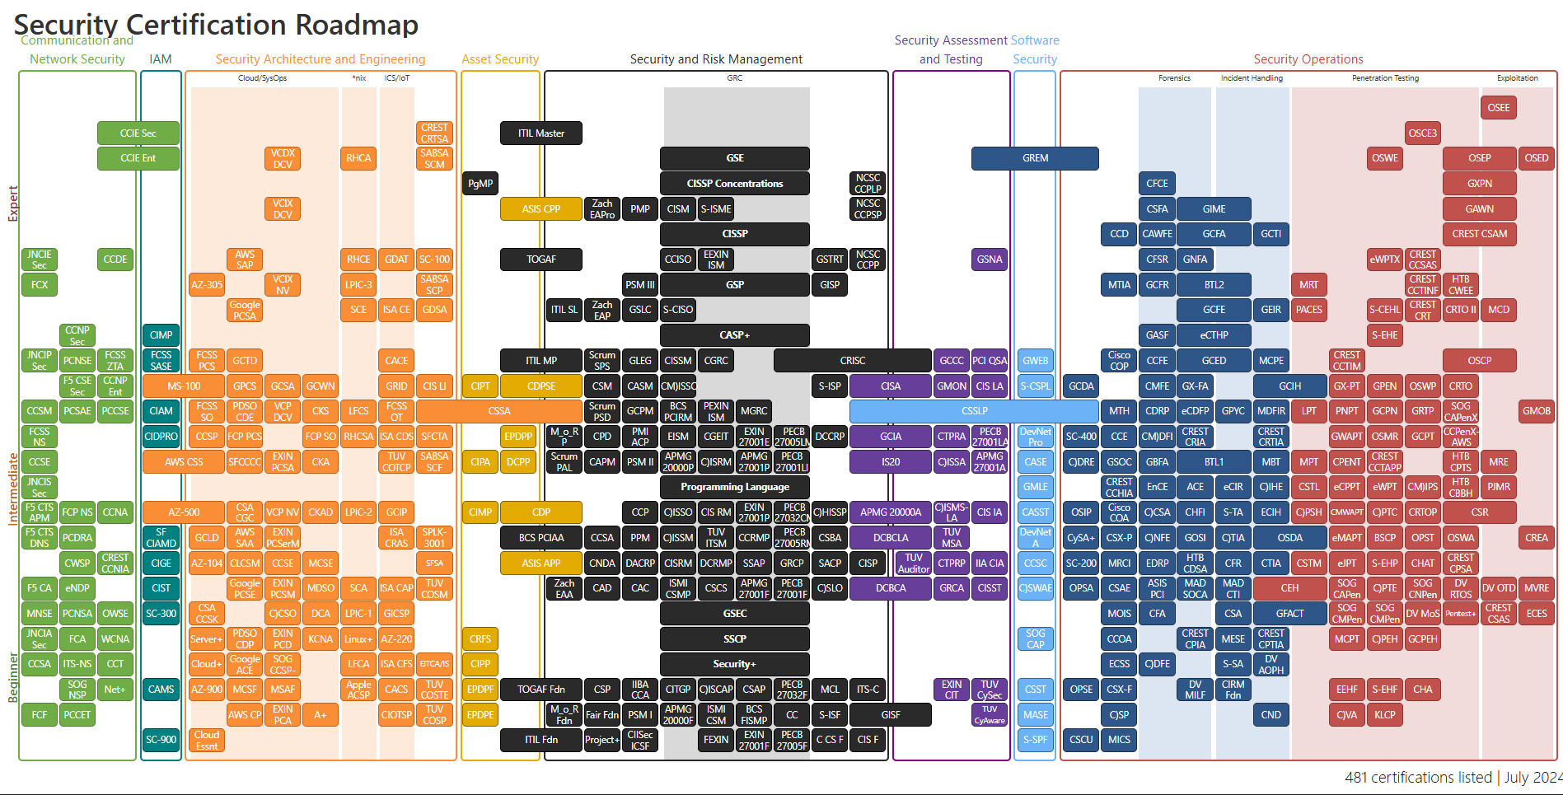
Certifications

Slide 17
Certifications self study
ISC2 (ISC2 Certs)
Cybrary (COMPTIA, Cisco CCNA, Certified ethical hacker)
Exam topic (more than 170 cert providers)
Cybersecurity youtube playlist
ISC2 by secure the humans
CCNA by information technology

Slide 18
Internships?

Slide 19
05
References

Slide 20
References
https://www.cisco.com/site/us/en/learn/topics/security/what-is-cybersecurity.html
https://www.hotcourses.ae/study-abroad-info/careers-prospects/cybersecurity-jobs/
https://www.salaryexpert.com/salary/job/cyber-security-analyst/egypt#:~:text=202.98%20%D8%AC.%D9%85.%E2%80%8F%20(,%E2%80%8F.
https://www.indeed.com/career/cybersecurity-analyst/salaries
https://encryptorium.medium.com/understanding-cybersecurity-teams-red-blue-green-white-and-more-a114ada67021
https://github.com/TalEliyahu/awesome-security-newsletters

Slide 21
06
Future Plans

